Slide 1

TRAINING WORKSHOP
NCDC, Abuja
12-16th Feb 2024

Slide 2
Who are we?
Kirstyn Brunker
Criselda Bautista
Martha Luka
Kathryn Campbell
Sandeep Kasaragod
Smitha Abraham
Notes:
Creeping death

Slide 3

Workshop etiquette
Treat each other with respect
General lab rules apply
Turn off your cellphones
For demonstrator attention: raise a hand
Participants can ask questions at any time following a raised hand
Everyone may take a moment to step out of the room discreetly without explanation at any time

Slide 4
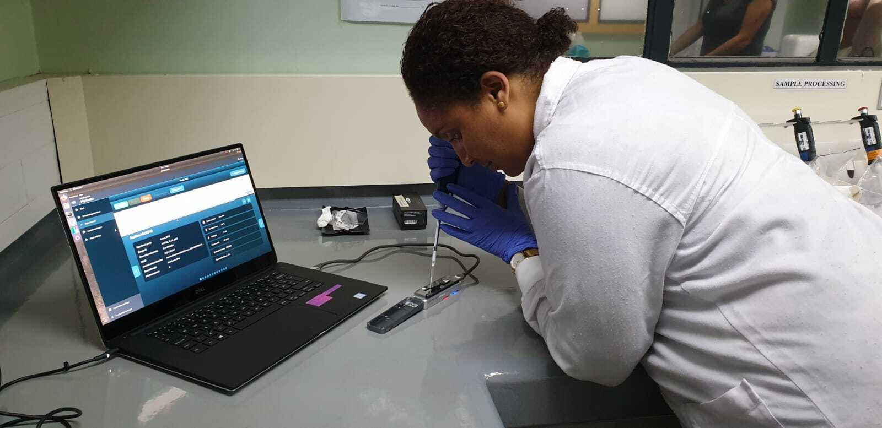
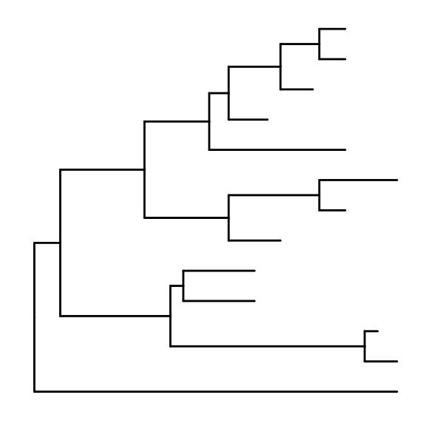
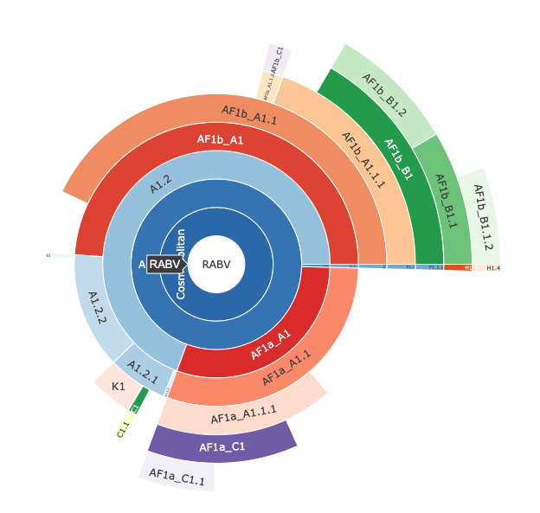
Workshop content
An introduction to genomic surveillance for rabies virus
Wet lab
Sequencing library preparation
Nanopore sequencing
Monitoring the run
Dry lab
Processing raw data
Building trees
Visualising & interpreting your data

Slide 5
Bautista et al., JoVE

Slide 6
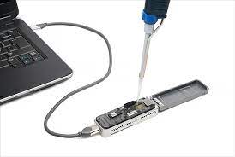
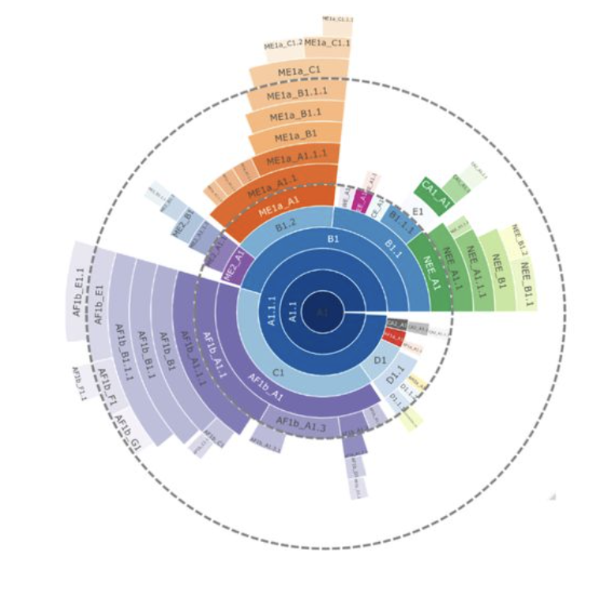

Schedule
MONDAY | TUESDAY | WEDNESDAY | THURSDAY | FRIDAY
OPENING WET LAB STARTER | WET LAB | WET LAB/DRY LAB | DRY LAB | DRY LAB
Background & lab intro | Masterclasses & Nanopore library prep I | Nanopore library prep II & sequencing Intro to Bioinformatics | Bioinformatics pipeline Alignments & Phylogenies | Advanced analysis, interpretation & visualisation

Slide 7
Who are you?

Slide 8

Speed dating!
Split into 2 groups
3 minute rounds
Each person takes it in turn to answer set of questions (next slide)
Each answer q1 before moving on to next q… etc
At the end of each round (DING!):
Group 1 stays seated
Group 2 rotates

Slide 9
Questions
Introduce yourself
What are you hoping to gain from the workshop?
If you could be an animal- what would you be and why?
Q1
Q2
Q3
NEXT

